Slide 1
Error 404
Team Members:
Roshni Jain
Pranjal Sharma
Carmen Tellez
David Mull
Christopher Lay
Christian Plaue
School of Prosperity

Slide 2
Systems Requirements 1 of 2
Business need: Handle the increased demand of enrollments
Business value: Conservative estimates of tangible value to the company includes:
· Reduces workload on the staff, increasing efficiency.
· Focus on staff development/training
· Saving time for student to focus on school
· Reduce information input error
Business Requirements: The functionality that the system should have is listed below:
· Handle records for students
· Self-registration
· View courses offered by the institution
· Handling high traffic from student registration

Slide 3
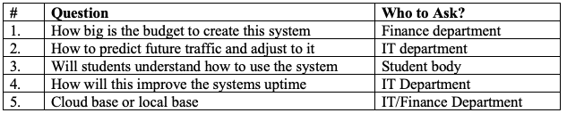
Systems Requirements 2 of 2
Special Issues or Constraints:
· Cost of operations
· The old operating system they currently are using will conflict with the new core system we are creating to deal with the increased volumes.
Notes:
· With the increase in high volume a new system is necessary for the implementation of a self-served online registration system to allow for the students to efficiently register and decrease the workload. The answers to these questions revolved around making the system efficient for both the students and the staff.

Slide 4
Systems Definitions
Non-Functional Requirements
1. Using windows/Mac OS
2. Handle high volume traffic
3. Removes multiple processes for registration filling. Registering directly to online
Functional Requirements (with details)
1. Eliminates paper format
2. Students may submit their forums online directly to the staff
- Faster for connection and lessen the workload
3. Students may view courses offered either offered online and face to face
4. Students may view grades for classes they’ve completed
5. Students may self-register directly for classes
6. Allows staff to look at students record system

Slide 5
Feasibility analysis 1 of 4
Technical Feasibility: Can we build it?
Familiarity with Functional area: Less familiarity generates more risk
· The staff will be familiar using a system that maintains the students’ record, grades, and courses.
· The students will be familiar with the process of registering for a course(s).
o Only difference is that the students will be given access to additional features than before.
· Analysts should be familiar with the concept of a Student Record System or understand the business process of registering students into courses.
o The manner of executing the system will be the difference of prior systems.

Slide 6
Feasibility analysis 2 of 4
Technical Feasibility:
Familiarity with Technology: Less familiarity generates more risk
· Staff, students, analysts are familiar on how to access the platform of a website through any electronic device with internet.
o Tablets, Phones, Desktops, Laptops
Project Size: Large Projects have more risk
· large projects require more time and effort and that is fulfilling in the long run as it would incur profits to the school and reduce workload of the staff with the paperless registration. It would avoid future errors in registration.
Compatibility: The harder it is to integrate the system with the company’s existing technology, the higher the risk
· Company is still able to use the existing technology but it will need a website platform in order to allow students to self-registration and other features.

Slide 7
Feasibility Analysis 3 of 4
Economic Feasibility: Should We Build It?
Intangible Costs and Benefits
Costs:
· Time spent:
o Developing training for staff and students to adjust to the new system
o Building the system itself (SDLC)
Benefits:
· Reduces workload of the staff during the beginning of each semester, which will increase their efficiency
· Staff can focus on staff development and/or training
· Reduces the amount of input information errors
· Reduces the response time of students being put into their course(s)
· Staff can work anywhere internet is accessible

Slide 8
Feasibility Analysis 4 of 4
Organizational Feasibility: If We Build It, Will They Come?
Strategic Alignment: The project is strategic in terms that each step has sub-steps where the student access it. While students are registering their classes online the staff can take a look of it from any location which has an internet connection and a browser. If any student has a problem registering for class, the staff would be notified and would fix the issue immediately. The project has logic and it is aligned one after the other the steps in a sequence.
Stakeholders
· Is the project strategically aligned with the business? : Strategically aligned with the business.
· Project Champion(s): Registration office and School of Prosperity.
· Senior Management: Staff and Advisors
· Users: Students
· Other stakeholders: Different departments across the school.
Notes:
The project is technical, economical and organizational feasible to build. This is a large project which would require more resources and more time but it would be benefitial in the long run. This project is worth investing in for because the school staff instead of focusing on registration which can be done online they can do trainings and workshops and gain more skills. It is a win-win situation for the IT department as well the Business department of the school. Guidelines to register can be provided in the intial stages of launching this project for students to understand the process.

Slide 9
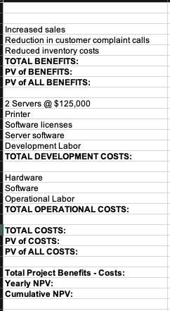
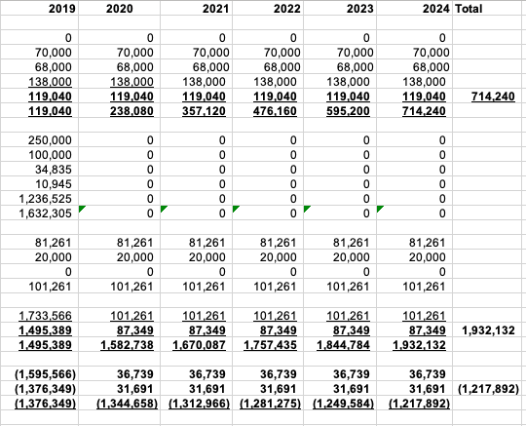
Cost benefit analysis
Total Tangible Benefits over 5 years: 3,204,752
Total Costs over 5 years: 2,575,331
NPV after 5 years: 629,421
ROI after 5 years: 36.28%
Break Even Point: 3.6

Slide 10
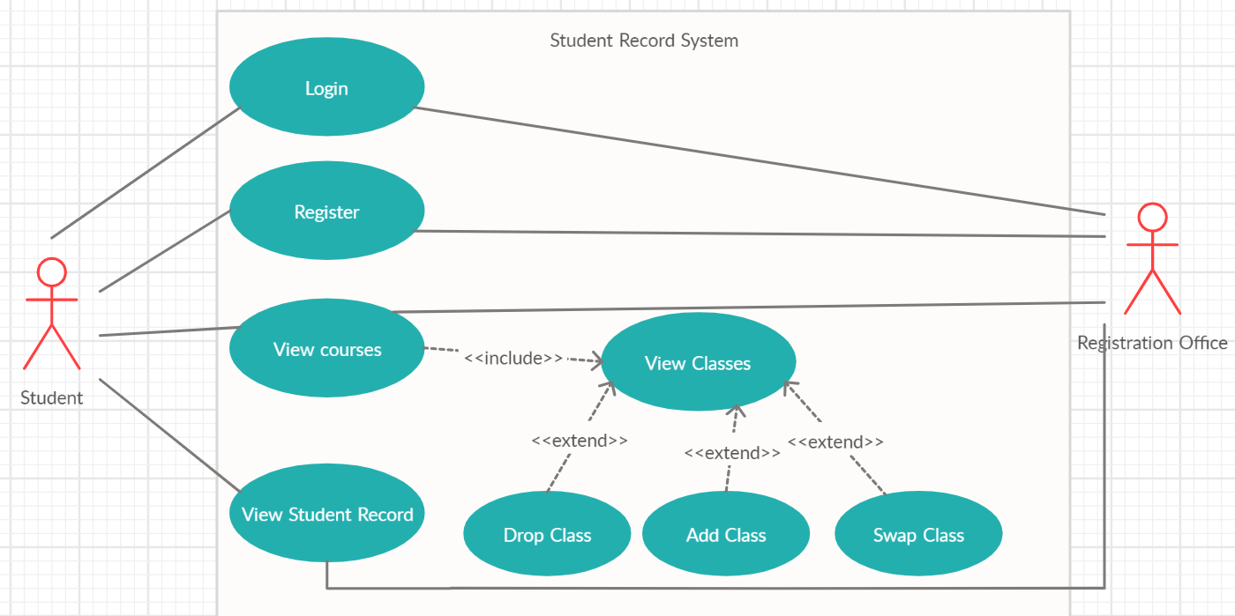
Use case diagram

Slide 11
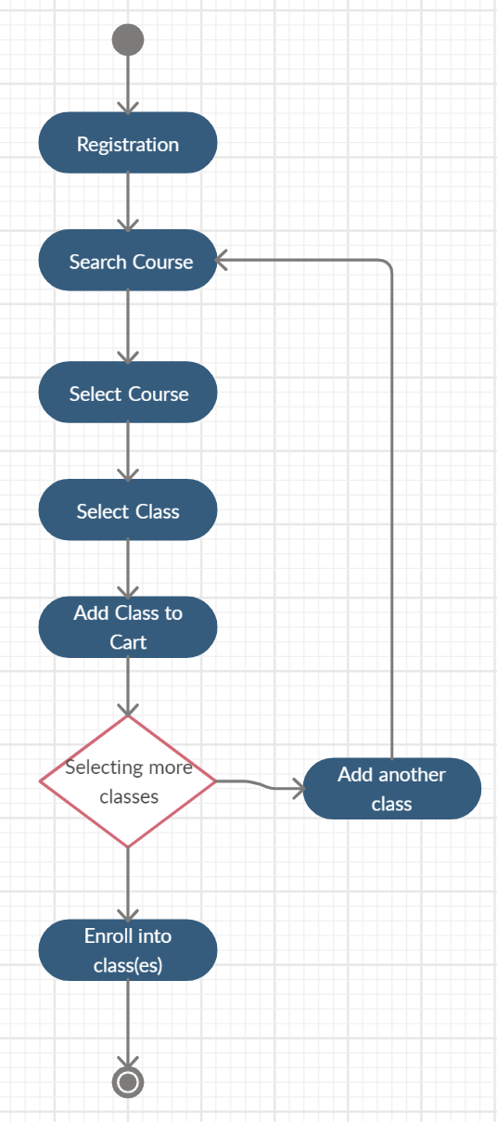
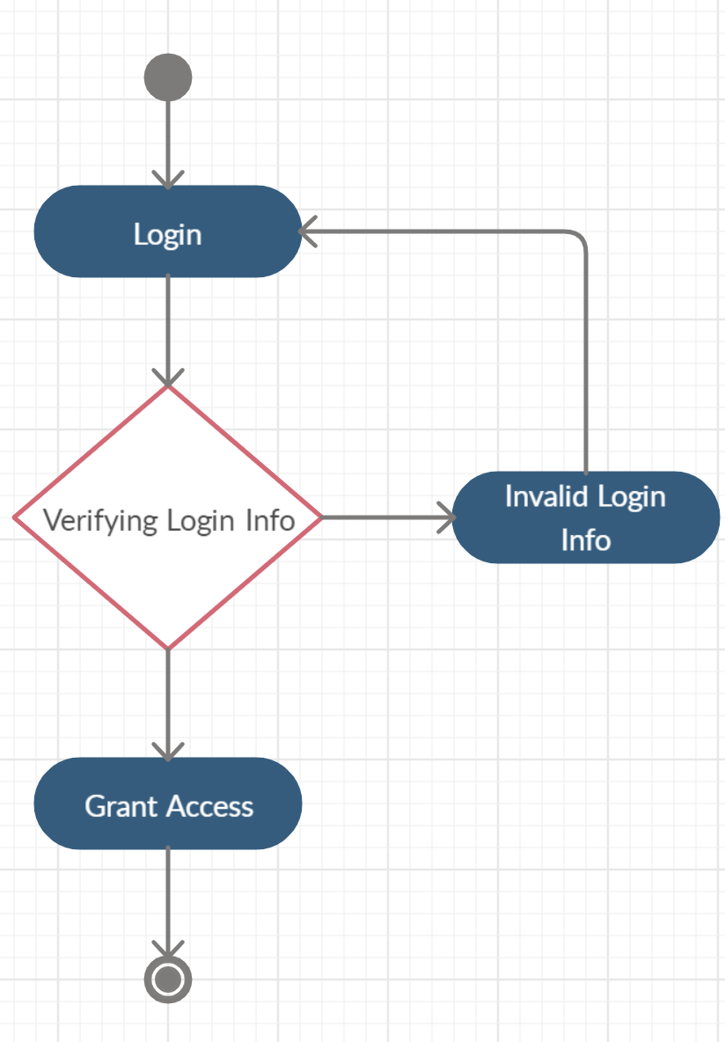
Activity Diagrams:
Log in
Registration

Slide 12
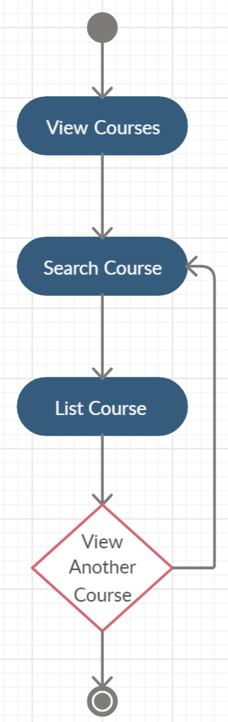
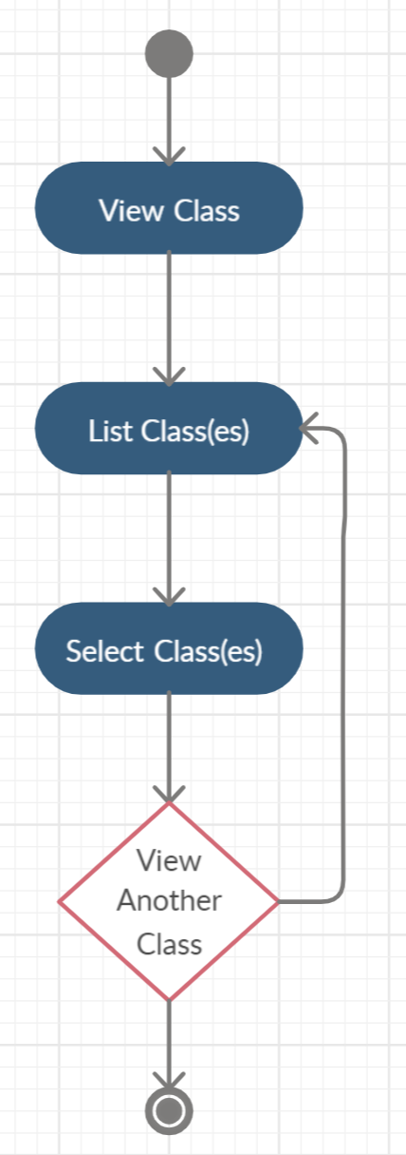
Activity Diagrams:
3. View Courses
4. View Classes

Slide 13
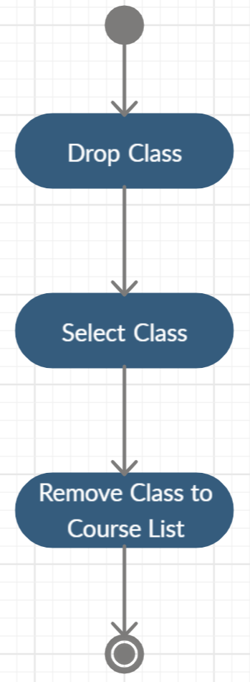
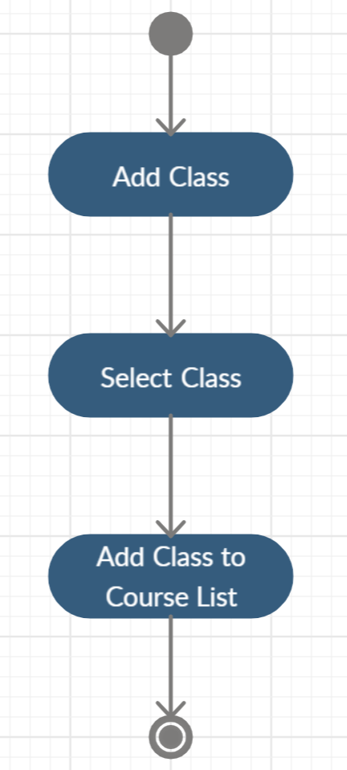
Activity Diagrams:
5. Add Class
6. Drop Class

Slide 14
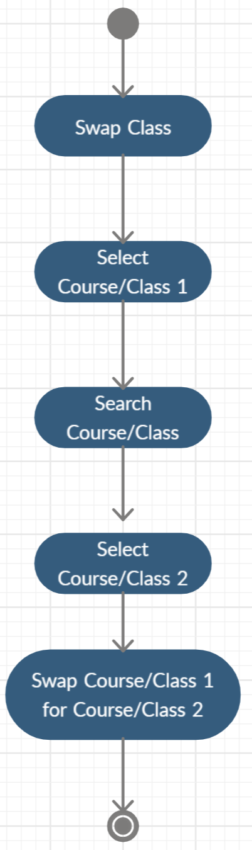
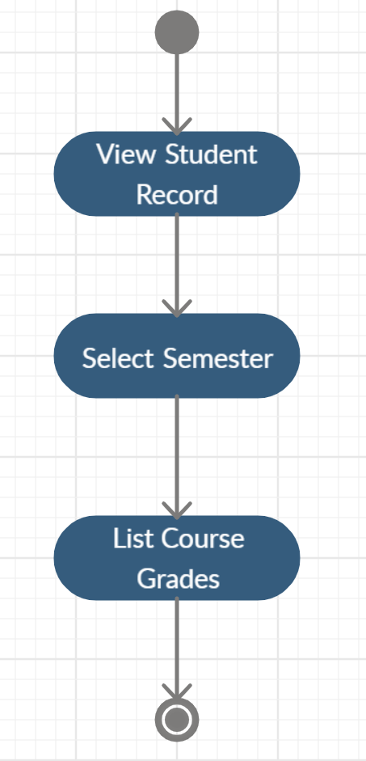
Activity Diagrams:
7. Swap Class
8. View Student Record

Slide 15
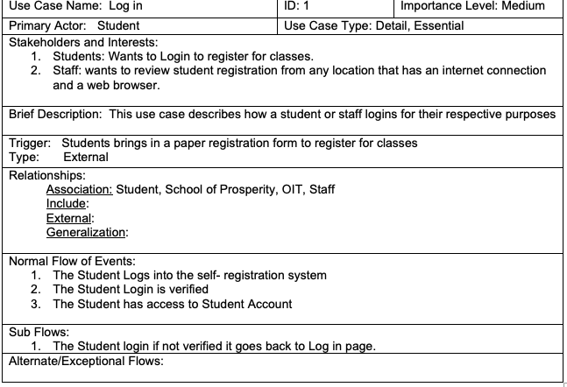
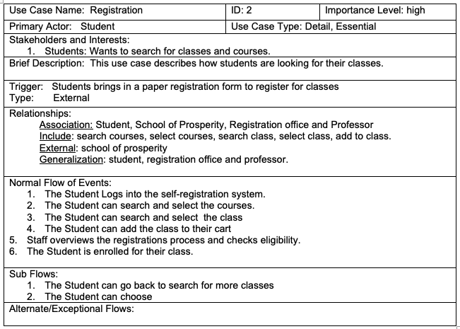
Use Case Descriptions:

Slide 16
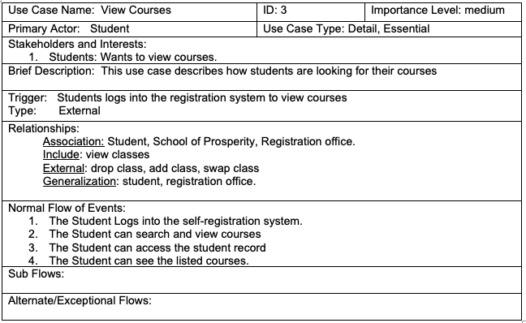


Slide 17
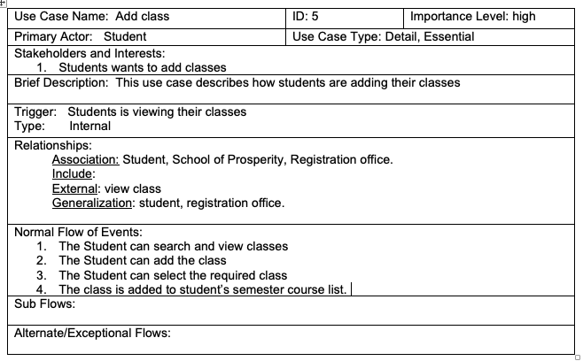
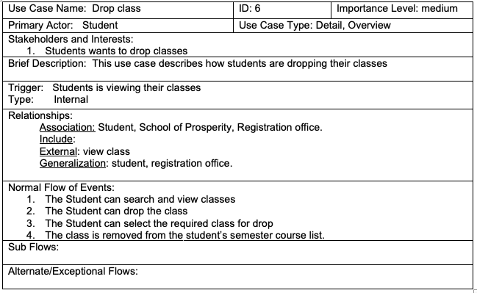

Slide 18
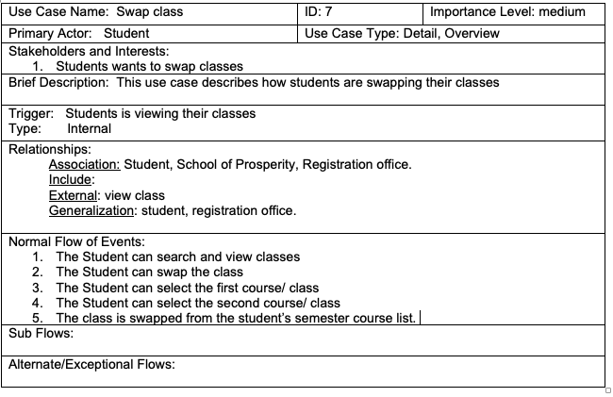
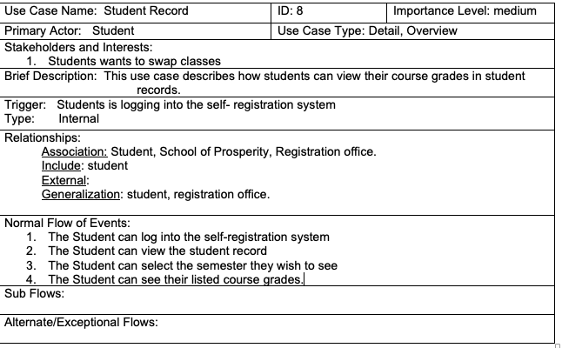

Slide 19
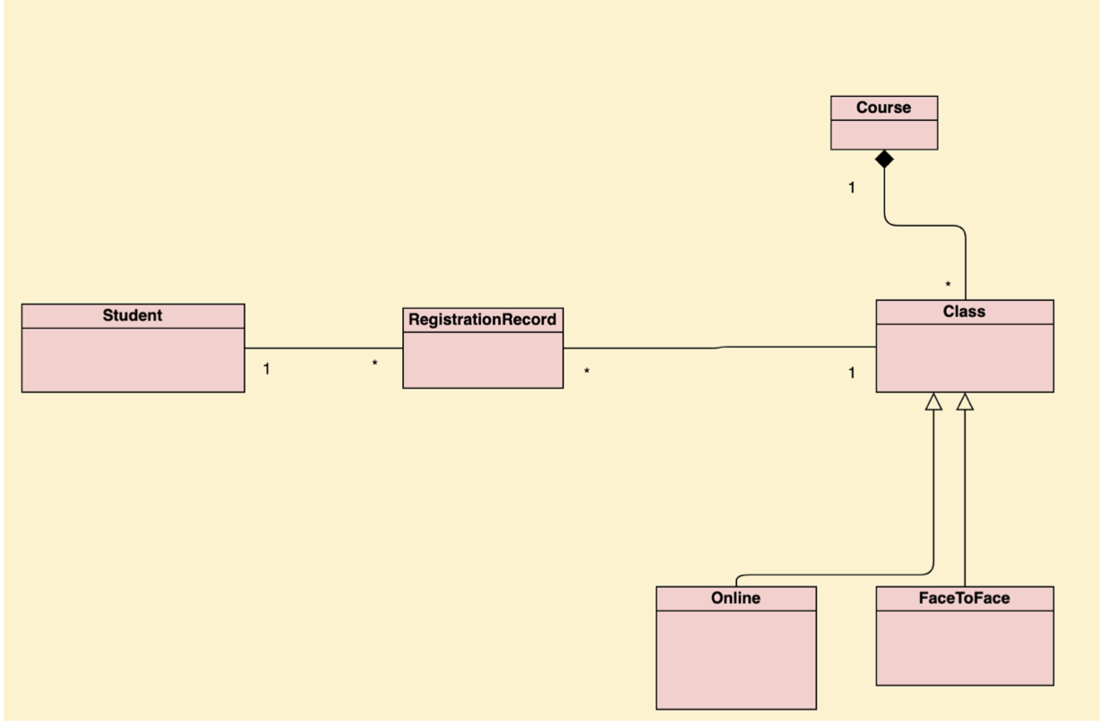
Class Diagram

Slide 20
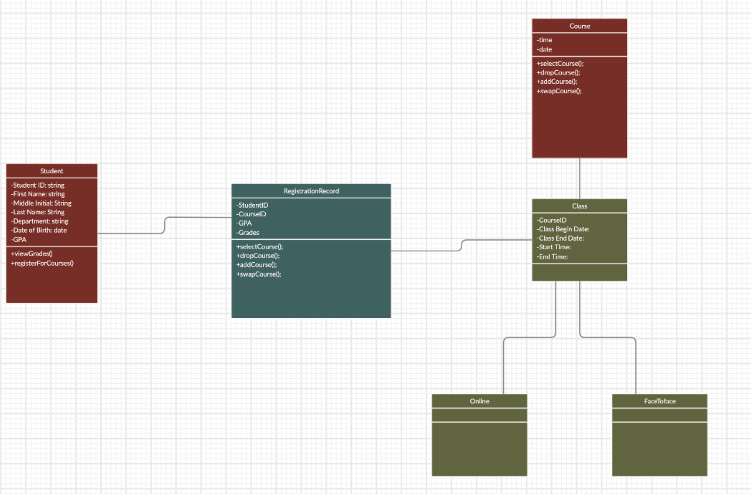
Class/UML Diagram

Slide 21
CRC CARDS
Student Class
Class Name: Student | ID: Error! Reference source not found.1 |  | Type: Concrete, System
Description: A student of the university who wants to view grades and register for courses |  |  | Associated Use Cases: 4
Responsibilities Log-in to the system, submit forums, view grades, view courses, register for courses |  | Collaborators Student, Staff
Attributes: First Name, Middle Initial, Last Name, Department, Student ID, Date of Birth, GPA
Relationships: Generalization (a-kind-of): student, registration office, and Professor Aggregation (has-parts): Student Other Associations: School of Prosperity

Slide 22
:
CRC CARDS
Registration Record Class
Class Name: Registration Record | ID: Error! Reference source not found.2 |  | Type: Concrete
Description: registration record of students |  |  | Associated Use Cases: 3
Responsibilities A function for students & staff to view courses, student registration record & student grades |  | Collaborators Student, Staff
Attributes: View courses, access student record, view grades
Relationships: Generalization (a-kind-of): System Function Aggregation (has-parts): Student Records Other Associations:

Slide 23
:
CRC CARDS
Courses Class
Class Name: Courses | ID: Error! Reference source not found.3 |  | Type: Concrete
Description: Courses offered |  |  | Associated Use Cases: 4
Responsibilities Access student record, list courses |  | Collaborators Student, Staff, Class
Attributes: Time, Date, select course, drop course, add course, swap course,
Relationships: Generalization (a-kind-of): System Function Aggregation (has-parts): Classes, Grades Other Associations: Student

Slide 24
:
CRC CARDS
Classes
Class Name: Classes | ID: Error! Reference source not found.4 |  | Type: Concrete
Description: Classes offered under each course |  |  | Associated Use Cases: 3
Responsibilities Access student record, list classes |  | Collaborators Student, Staff, Courses
Attributes: Course ID, Class Begin Date, Class End Date, Start Time, End time
Relationships: Generalization (a-kind-of): System Function Aggregation (has-parts): Grades , FaceToFace, Online Other Associations: Student

Slide 25
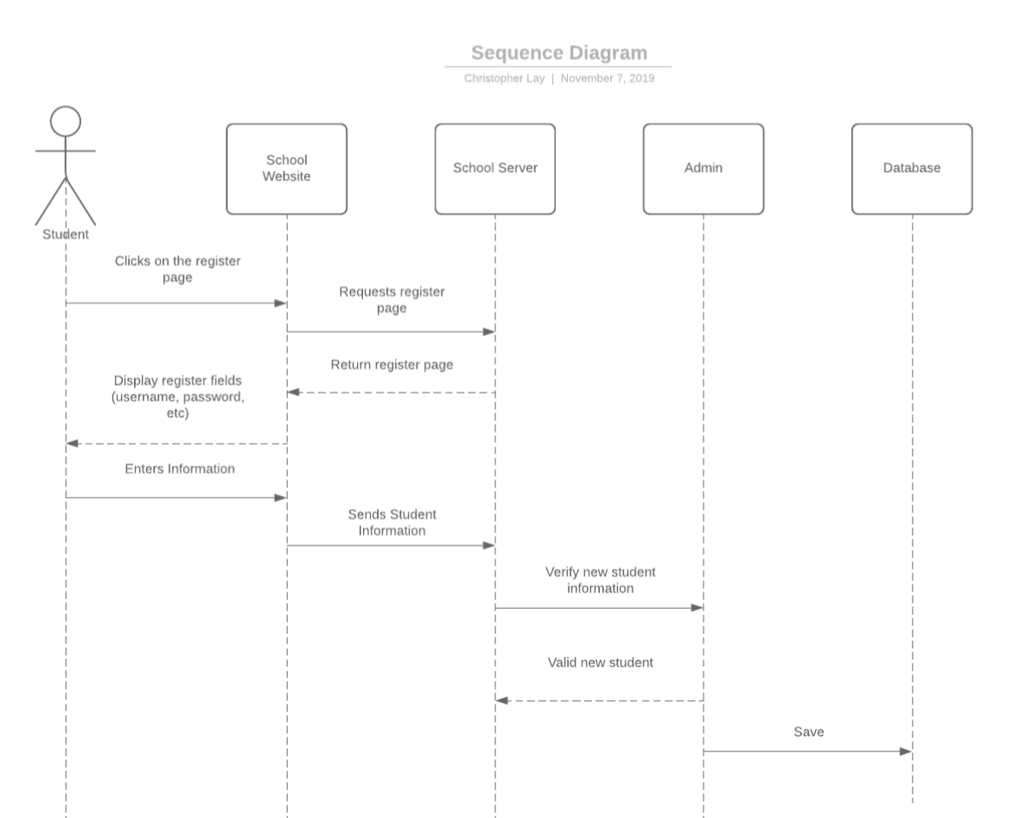
Sequence Diagram

Slide 26
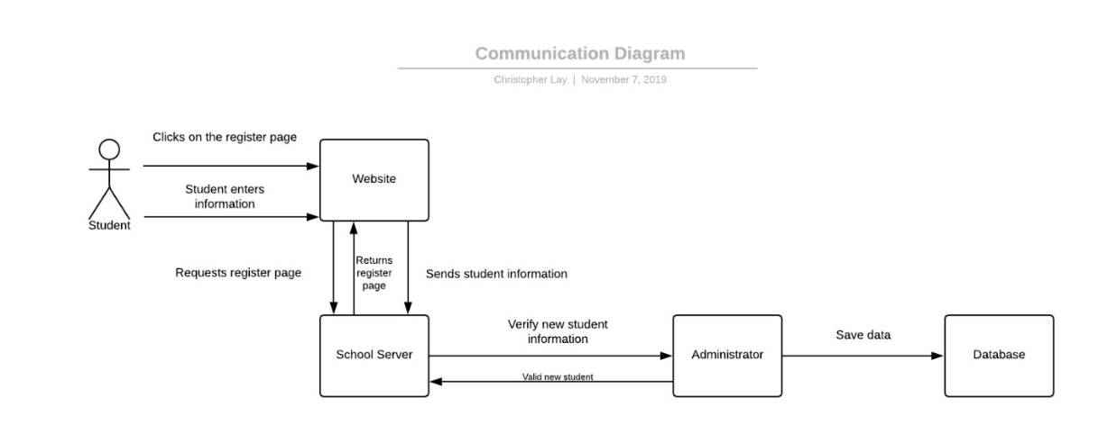
Communication Diagram
Communication Diagram

Slide 27
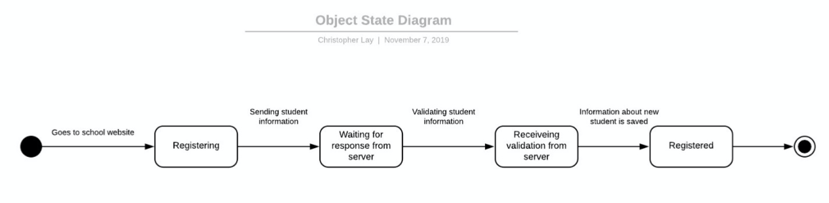
Object State Diagram
Object State Diagram

Slide 28
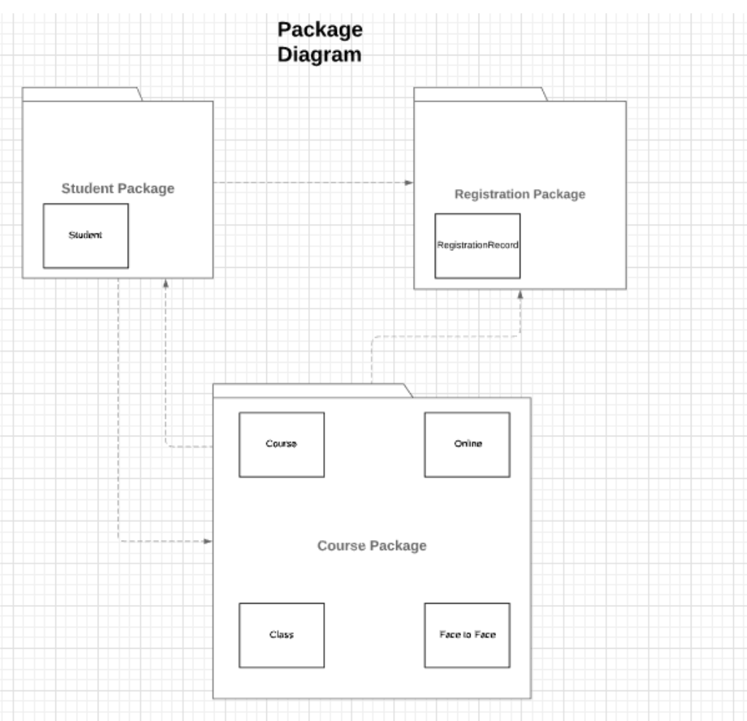
Package Diagram

Slide 29
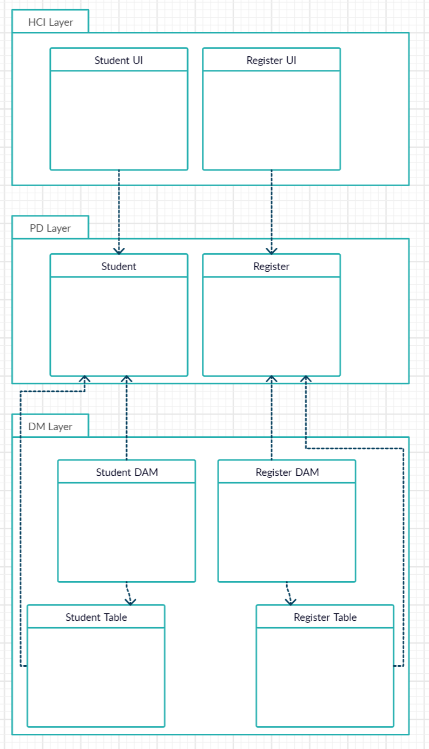
HCI, PD, DM Layer
Notes:
HCI, PD, DM LAYER

Slide 30
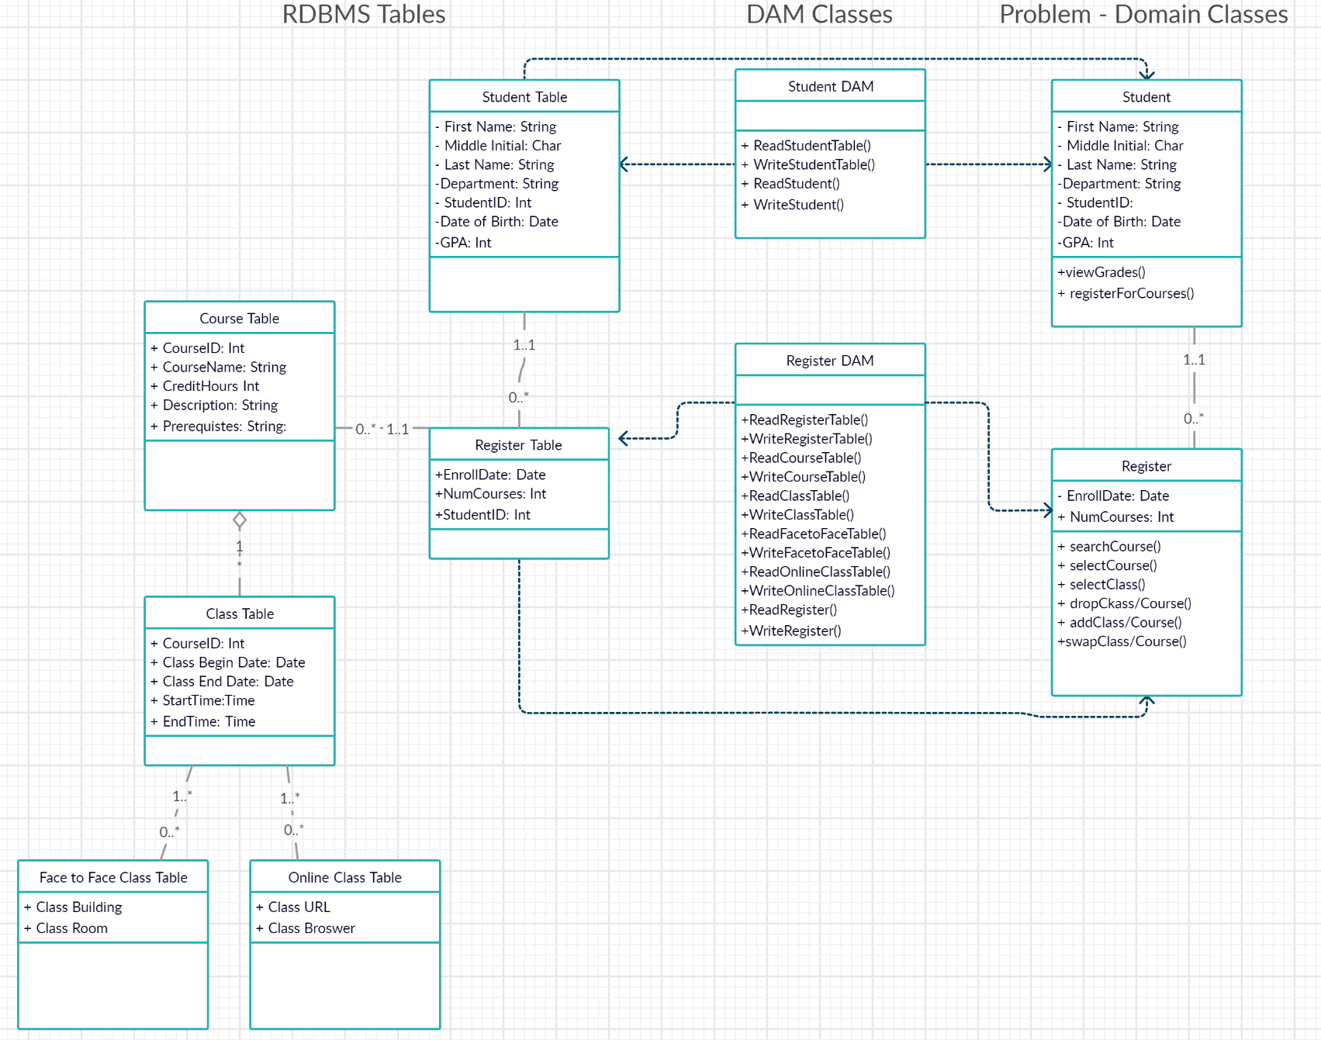
Mapping of Problem Domain Objects to RDBMS Using DAM Classes
Notes:
DAM layer

Slide 31
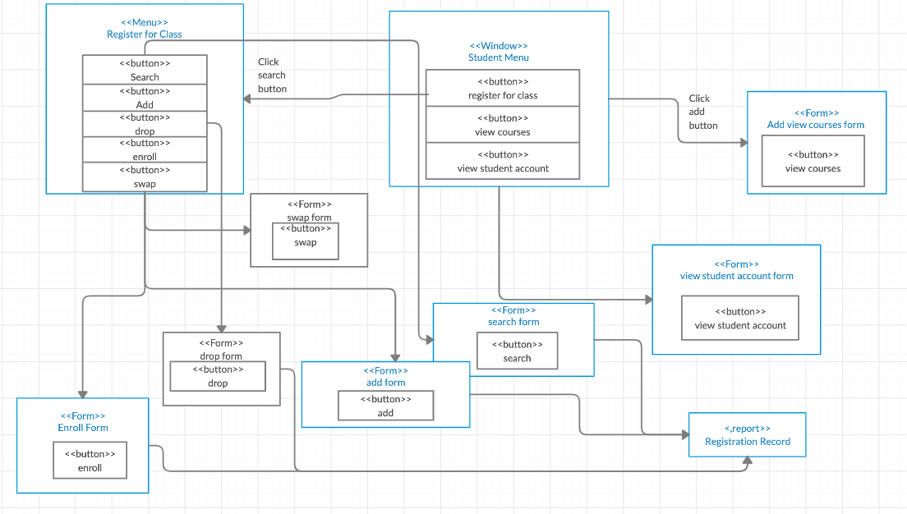
Windows navigation diagram

Slide 32
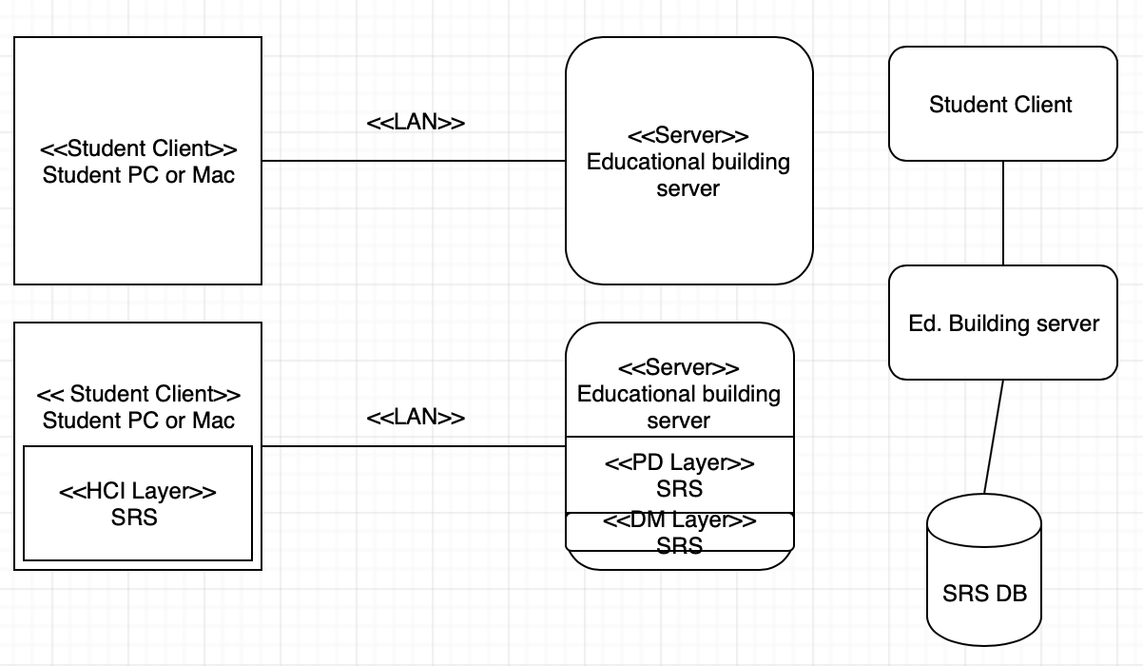
Deployment diagram

Slide 33
Test Plan
Testing the functionality of the systems
Run the interfaces through testing
Allowing to view the user’s point of view
Functions of the code
Confirm buttons are working correctly
Confirm system sends a validation message after entering all the correct data and submits on to the server.
Confirms system checking for class availability as well as notifies if class is full.
Verify confirmation was sent to the student
If any issues arise, users can notify us by sending an email

Slide 34
Conversion Strategy
The first conversion strategy we will implement is Parallel Conversion. We are using the parallel conversion strategy first to determine the results of the new system and the old system and if the new system’s results are similar to the old system then we can make the old system obsolete and implement the new system fully.
The implementation of the new system will use the Direct Changeover strategy which means that on a specified date and time the end-users will stop using the old system and the new system will be integrated. This strategy will only be used once the results are approved of and when end-users are not using the system timewise.

Slide 35
Post implementation activities
Three tiered support system starting with school help desk technicians for troubleshooting at base level, advanced technicians for tier 2 support and any engineering-level requests can be submitted for review to our development team.
Devs/engineers will present product to the school’s onsite IT team and give tutorials on using the UI, managing the server, and accessing/editing the SRS database.
Patching can be performed monthly with coordination from IT team, or independently on a set day of the month during non-working hours.
Tutorials can be implemented to UI upon request

Slide 36

Sample User Interface

Slide 37
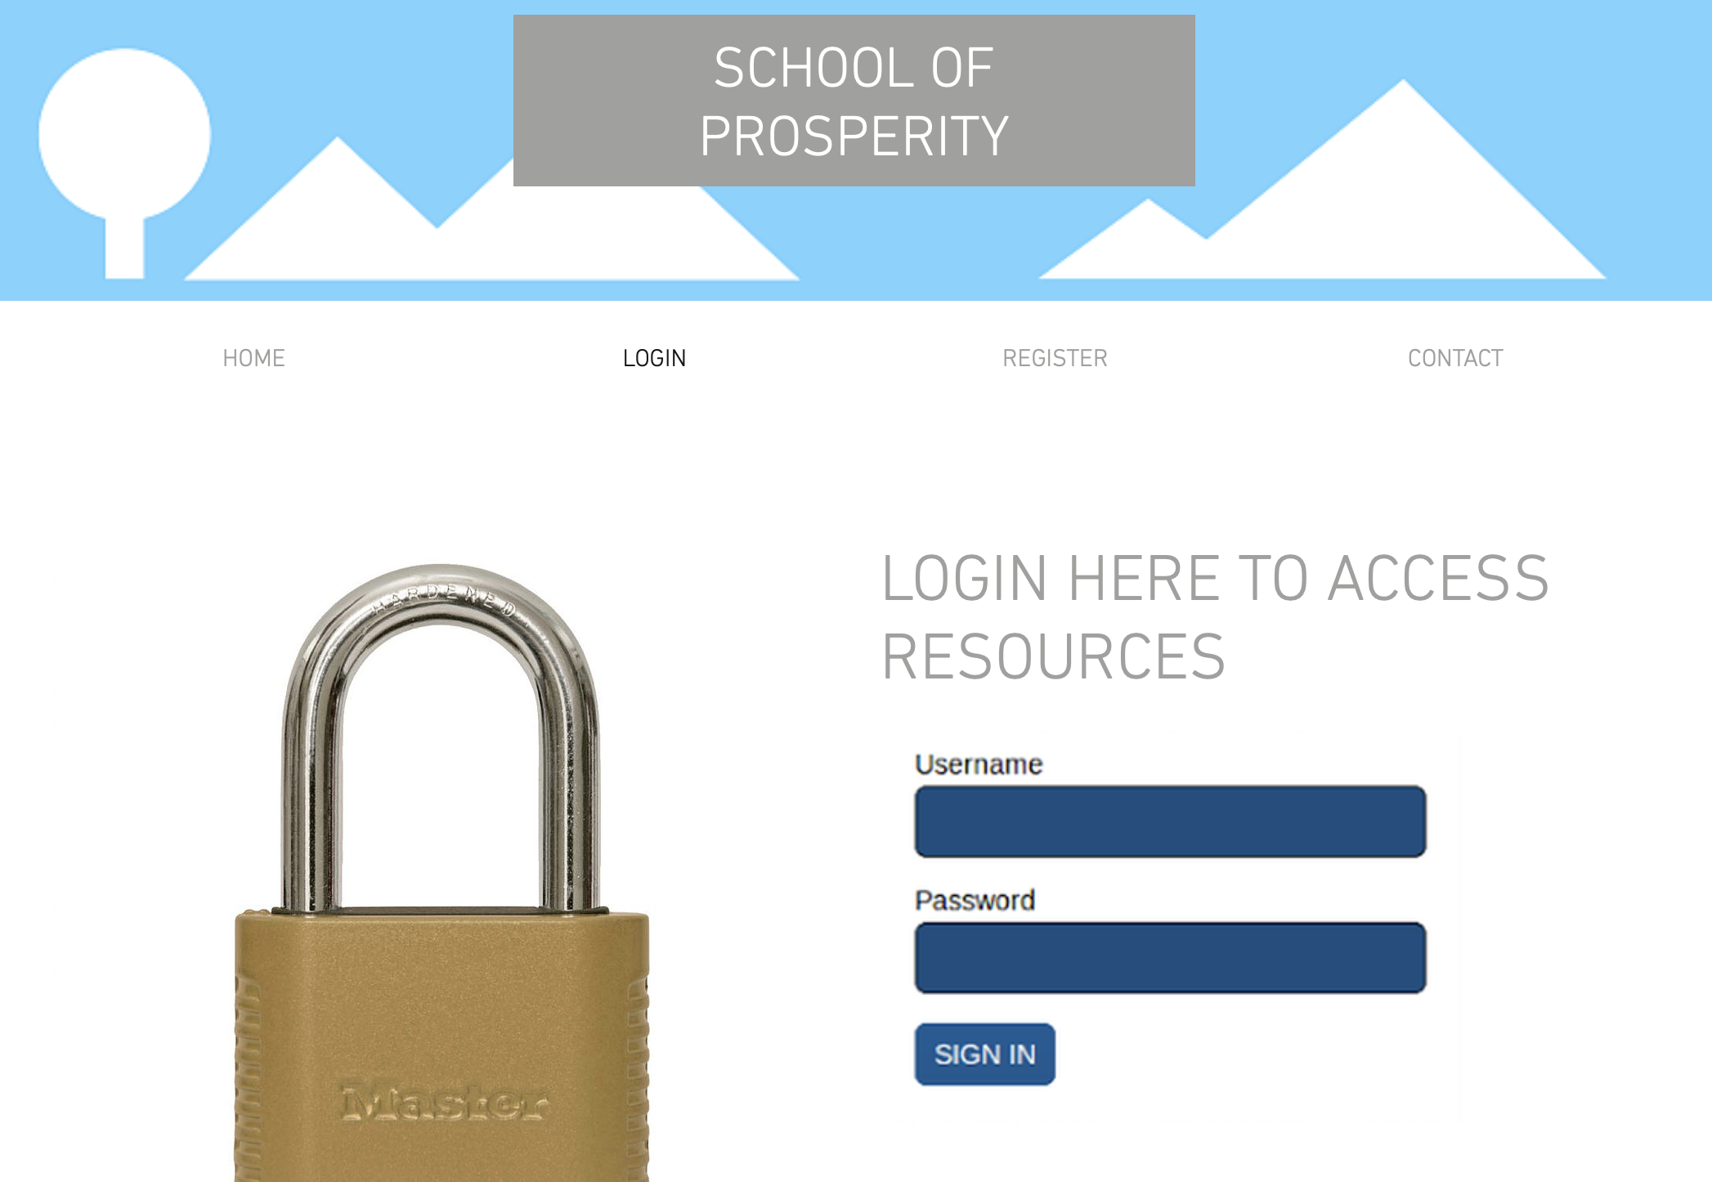

Slide 38
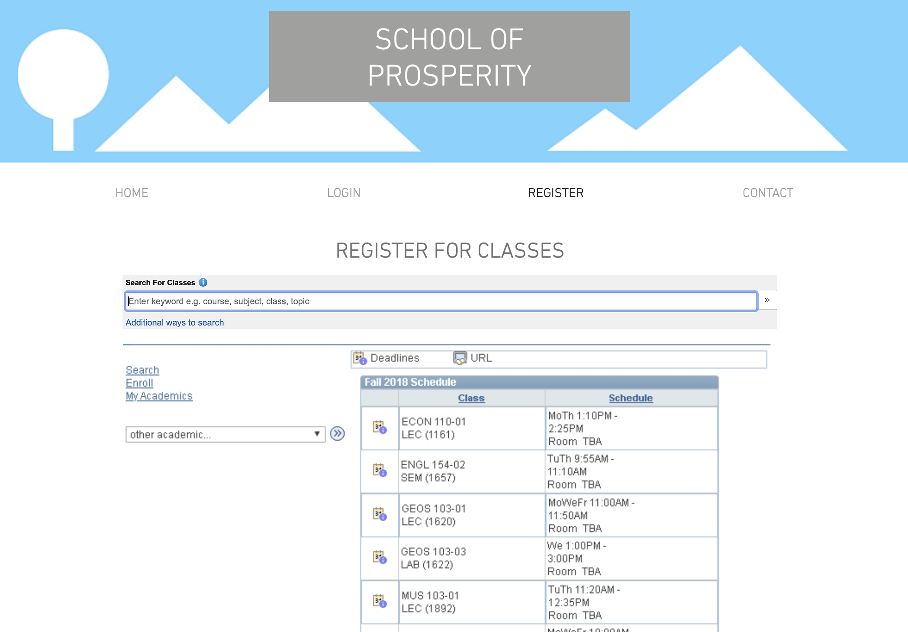

Slide 39
Questions ?

